Slide 1
RESTful API & Web Server

Slide 2
Overview
Introduction
API
Web Server

Slide 3
Objective
Able to use API tool(s)
Able to know access and read API
Able to build web server

Slide 4
Day 1

Slide 5
Introduction

Slide 6


Who I am
Name : Adhil Novandri​
Age : 33 years old​
Skill : Python, PHP, HTML, JavaScript, Bootstrap CSS, Tailwind CSS​
https://github.com/choconutella​
ChocoNutella​

Slide 7
What is API
An application programming interface (API) is a way for two or more computer programs to communicate with each other
source : https://en.wikipedia.org/wiki/API

Slide 8
What is REST API
REST is an acronym for REpresentational State Transfer and an architectural style for distributed hypermedia systems.
(source : https://restfulapi.net/)
A RESTful API is an architectural style for an application program interface (API) that uses HTTP requests to access and use data.
(source : https://www.techtarget.com/searchapparchitecture/definition/RESTful-API)

Slide 9
Why use REST API
Easy to Learn and Implement
Scalability
Cacheable
Flexibility and Portability
source : https://www.geeksforgeeks.org/why-rest-api-is-important-to-learn/

Slide 10
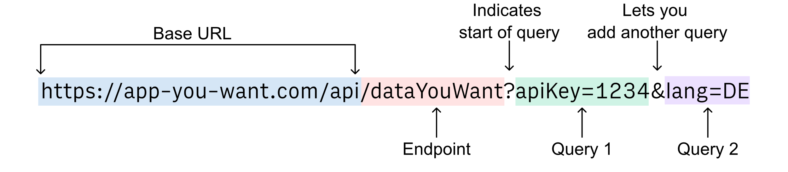
REST API Anatomy
source : https://rows.com/docs/getting-data-from-any-api

Slide 11
REST API Method Type
GET
POST
PUT
DELETE

Slide 12
Postman

Slide 13
What is JSON
JSON stands for JavaScript Object Notation
JSON is a lightweight format for storing and transporting data
JSON is often used when data is sent from a server to a web page
JSON is "self-describing" and easy to understand

Slide 14
JSON Structure
{ “key” : “value” }
Value Type :
String : “hello”
Integer : 10
Array : [“Monday”, ”Tuesday”, ”Wednesday”]
Boolean : True
Object : { “patient” : { “name” : “ChocoNutella”, “age” : 33 } }

Slide 15
Read Write JSON with Python
import json
data_on_json = { “name” : “ChocoNutella”, “dob” : “10-10-2010” }
data = json.loads(data_on_json)
print(data[“name”])
# output : ChocoNutella

Slide 16
Quiz 1 – Processing JSON
Notes:
https://github.com/fawazahmed0/currency-api#readme

Slide 17
Quiz 2 – Currency Convert
Notes:
https://github.com/fawazahmed0/currency-api#readme

Slide 18
Quiz 3 – Study Case (RSUD Jagakarsa)

Slide 19
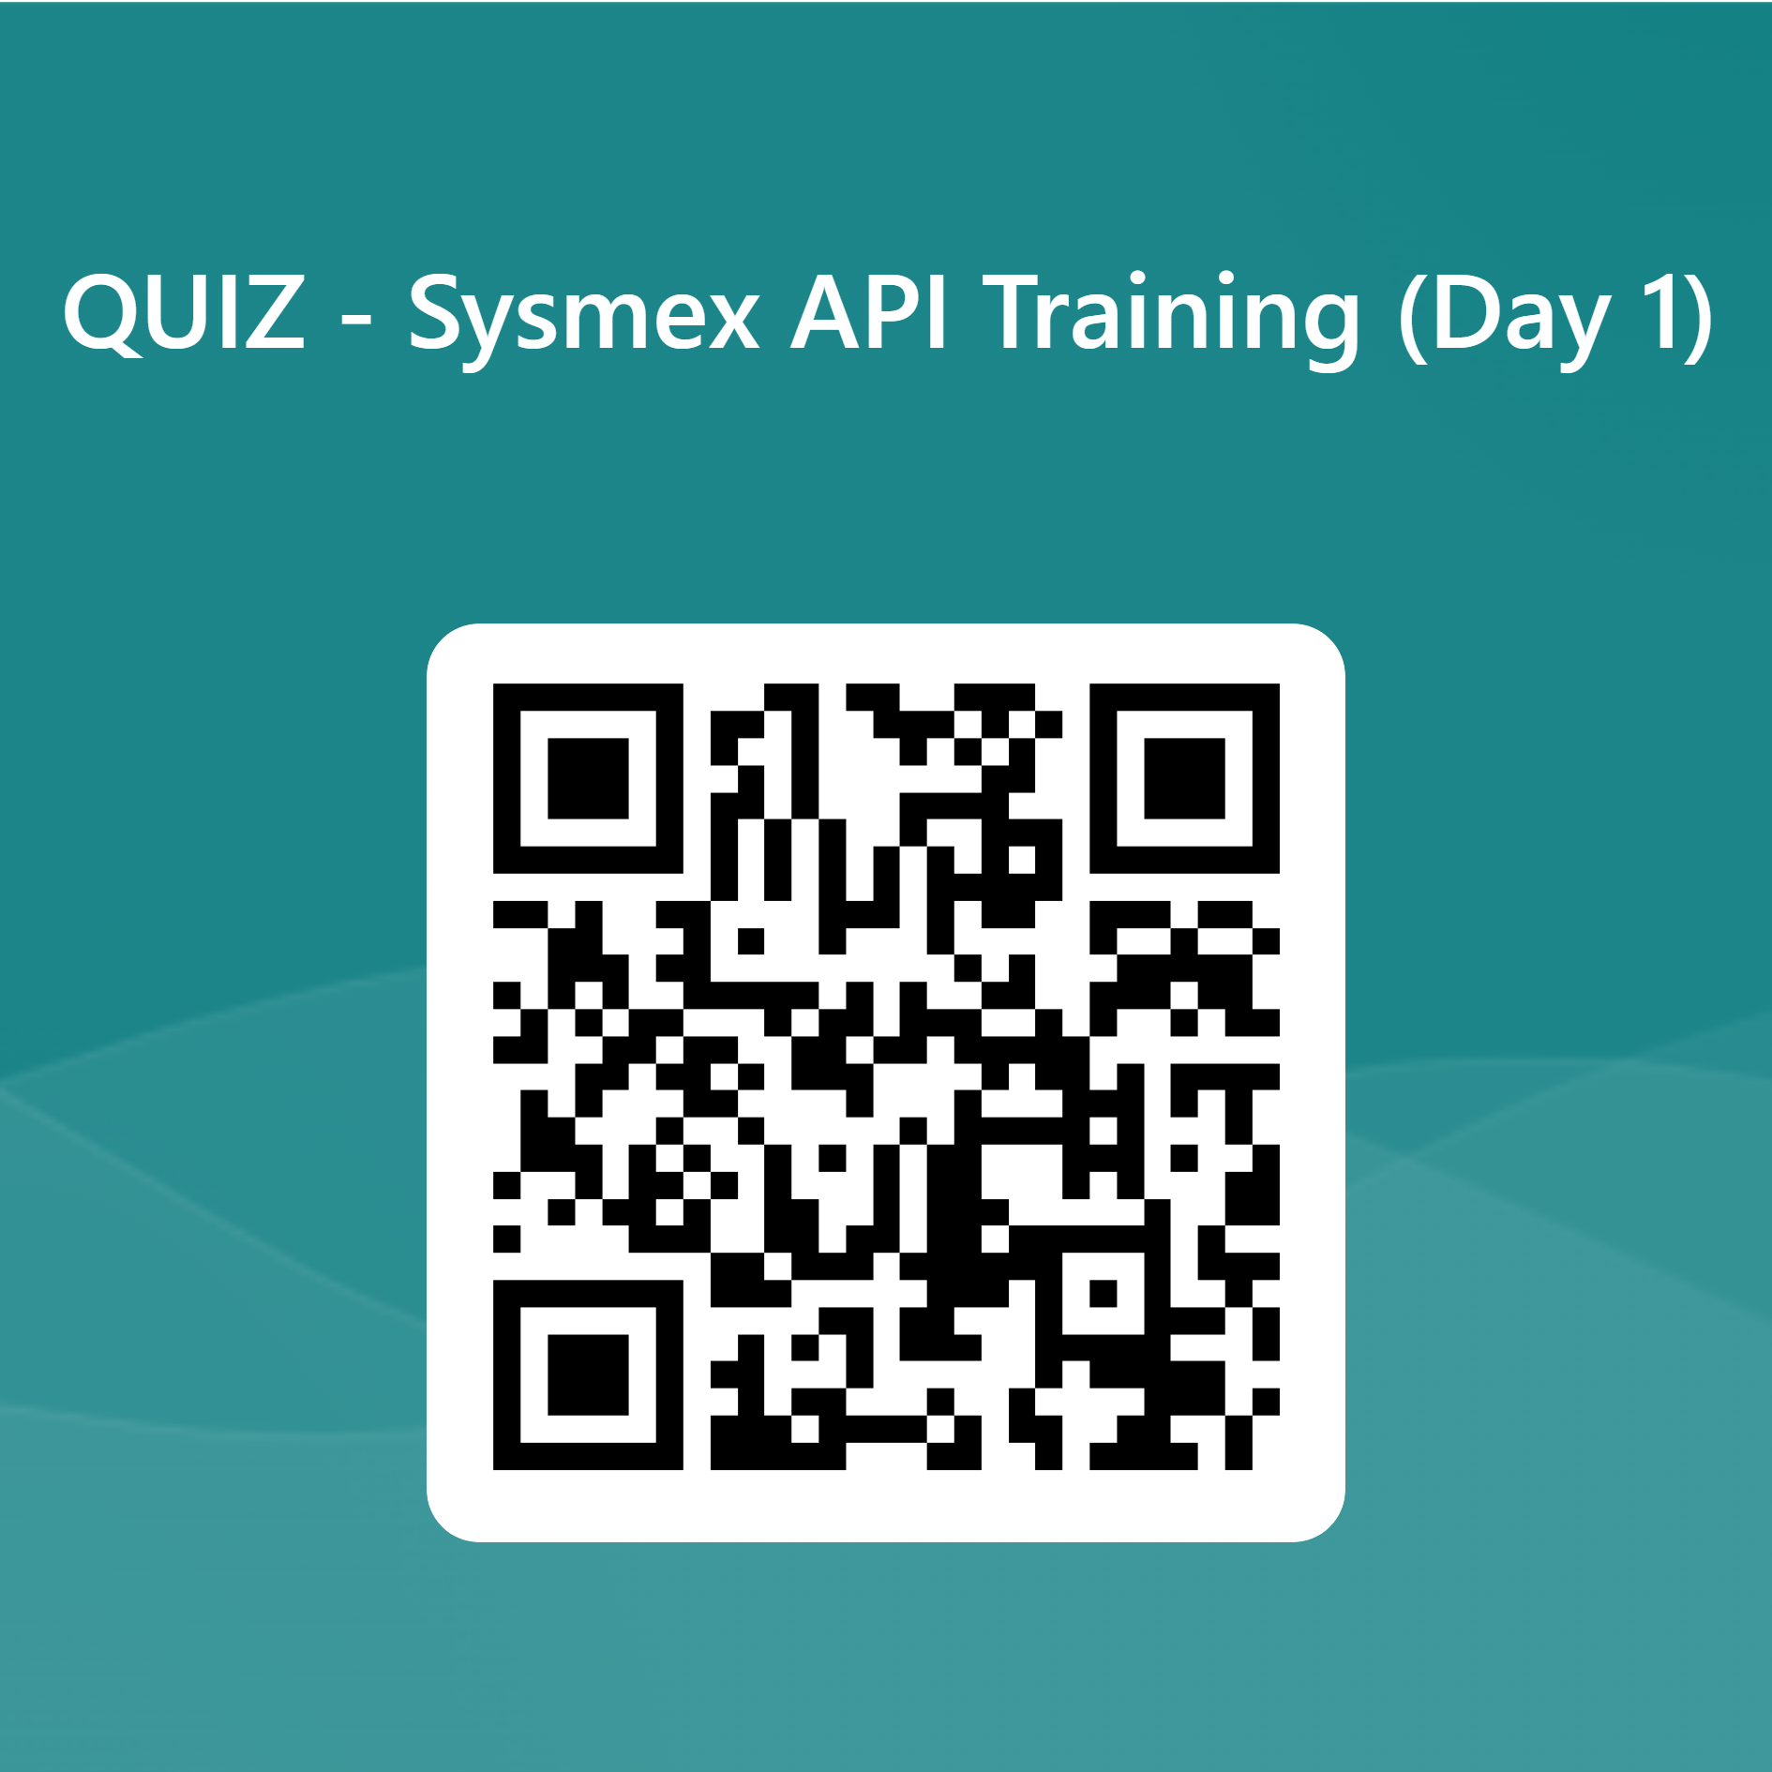

Slide 20
Day 2

Slide 21
Response
Response 1XX - Information
Response 2XX - Successful
Response 3XX - Redirection
Response 4XX - Client Error
Response 5XX - Server Error

Slide 22
Quiz 4 – Handle Response

Slide 23
What is Web Server
A web server is computer software and underlying hardware that accepts requests via HTTP or its secure variant HTTPS.

Slide 24
Web Server
Apache
Nginx
IIS
etc...

Slide 25


Python Web Framework

Slide 26
MVC Concept

Slide 27
MVC Concept
Model
View
Controller

Slide 28
Django Framework
# django
pip install django
# django restframework
pip install djangorestframework

Slide 29
Quiz 5 – Build RESTful API

Slide 30
Quiz 6 – Study Case (Bumame Clinic)

